Slide 1


Students’ Union
Ambassador Training

Slide 2

Session Aims
Role-Specific Breakouts
Gaining Confidence with session delivery
Inclusivity and Accessibility
Activities and Ideas
Working Collaboratively

Slide 3
Role- Specific Breakouts

Slide 4
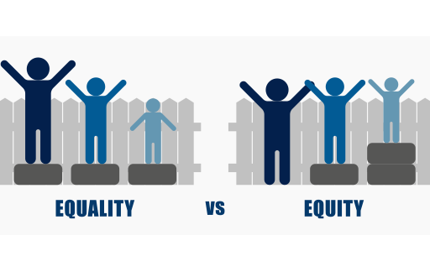
Inclusivity and Accessibility
Know your audience
Don’t make assumptions
Inclusion by design
It’s not about the intention, it’s about the impact
Question Yourself – If there’s any doubt, don’t do it!

Slide 5

Session Delivery and Public Speaking
Excellent presentation is 38% your voice, 55% non-verbal communication and just 7% your content
Seem like you have authority over the topic
Interest in the topic
This Photo by Unknown Author is licensed under CC BY-SA-NC
Notes:
Speak Nonsense Game
According to research, an excellent presentation is 38% your voice, 55% non-verbal communication and just 7% your content. In other words, your delivery matters even more than what you say, and this exercise helps you refine it. Find a paragraph online in a language you don’t understand or simply write down a few lines of jibberish, and practice saying it aloud as though you’re giving a speech. Pay mind to your tone, inflections, and generally how you can use your voice to create more interest.
One Minute Off-the-Cuff Game
For this exercise, you’ll set a timer on your phone for one minute and record yourself giving an impromptu speech on any topic that interests you. The only rule is that you can’t prepare for it in any way. This is designed to get you more comfortable speaking off-the-cuff and minimize the anxiety that comes from being afraid you won’t have anything to say.
Speak up! Game
Make a list of stupid statements. For example:
Santa Claus should be banned.
All cars should be powered by olive oil.
All board games should have pictures of kittens on them.
Humans should live in the ocean.
Why Lemons should be square.
Players are picking up a random paper with a statement.
They have 90 seconds since they picked the paper to persuade others why the "statement" is good idea and should be applied.
The more stupider and less meaningful the statement or question is the better.
People that are struggling with English they get up to 2 minutes but with no other help other than explaining to them the question or statement in their native language if possible.
You can not read out loud what the pepper says, only after your turn has ended.

Slide 6

Activities and Ideas
Do you have an overall goal for your session/activity?
  Is the content achieving that goal?
Does this engage everyone in attendance?
  Have you planned for adaptations?

Slide 7
Have a Go!
In small groups or pairs, come up with ideas for activities or sessions

