Slide 1

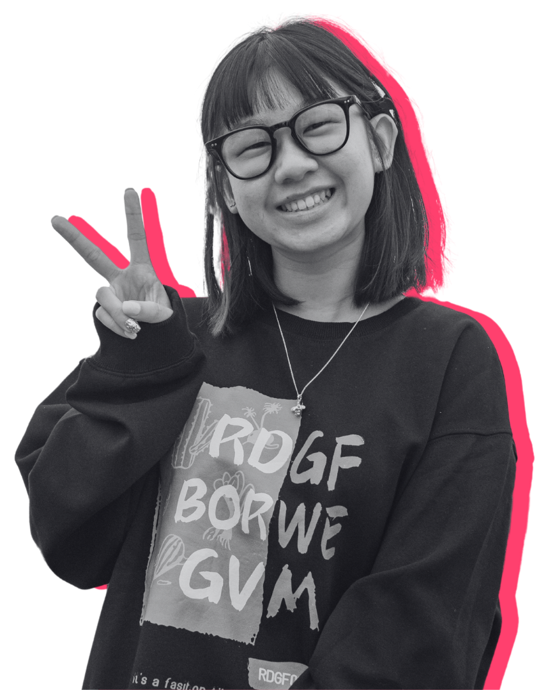
SOUTHERN UNIONS CONFERENCE 2026
FROM IDEA TO IMPACT
The journey of Herts Unfiltered
Muhammad Sakib
Insights Analyst · Hertfordshire Students' Union
1

Slide 2


WHERE IT STARTED
BEFORE HERTS UNFILTERED…
We knew students had valuable experiences to share — we needed a better way to hear them.
THE QUESTIONS WE KEPT ASKING
WHAT WE NEEDED
What do students want from university?
Hear from more diverse voices
Not just the students who always reply.
What stops them attending lectures and events?
Reach the students we were missing
Commuters, part-time, quieter courses.
Do they feel like they belong here?
Share insight fast enough to act
Findings in weeks, not at the end of the year.
What are their biggest challenges right now?
Make feedback feel worth doing
Something better than another email survey.
2

Slide 3




HOW IT CAME TOGETHER
TURNING AN IDEA INTO REALITY
From a conversation about a gap in our research to a project live on campus.
01
02
03
04
The idea
University support
Building the project
Launch
Recognising we needed a better way to hear student voices.
University funding turned the idea into something we could resource.
Student staff recruited, brand created, kit bought, questions designed.
Taking the conversation directly to students, across campus.
3

Slide 4
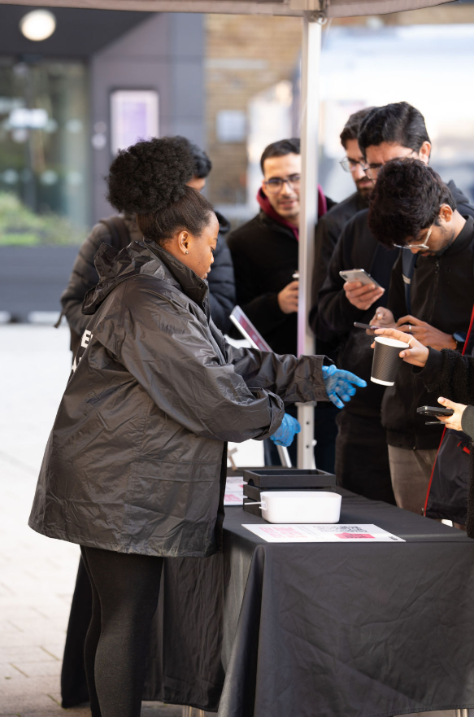
YEAR ONE · 2024/25
MEET HERTS UNFILTERED
Student conversations. Real-time insight. Meaningful action.
Student-led conversations across campus, not another inbox request.
Face-to-face with students — coffee in hand, in their space.
Real-time feedback shared with both the SU and the University.
Voices beyond surveys — the students we'd normally never hear from.
"Spill the Tea" — a free cup of tea (hot chocolate), and a real conversation.
4

Slide 5





YEAR ONE · DID IT WORK?
HERTS UNFILTERED — THE IMPACT
The response told us this had the potential to become something much bigger.
5,714
4500+
6 months
6 phases
Responses collected
Students engaged
Project duration
Delivery structure
Across the full year
Individual students reached
Start of term to mid-March
Across Semester A and B
WHY IT WORKED
Strong engagement right across campus, in every phase.
Meaningful conversations created meaningful insight.
We reached students who never complete online surveys.
Rich insight across every core theme we asked about.
5

Slide 6

YEAR ONE · WHAT WE HEARD
WHAT YEAR ONE TOLD US
Not Herts problems — sector problems. These are almost certainly showing up in your unions too.
Belonging
Cost of living
Connection
WHAT WE FOUND
WHAT WE FOUND
WHAT WE FOUND
Students could be surrounded by people and still feel like they hadn't found their place.
Money shaped everything: hours worked, days on campus, whether they joined anything at all.
The students hardest to reach were the ones who most wanted to be asked.
WHY IT MATTERED
WHY IT MATTERED
WHY IT MATTERED
Belonging isn't solved by more events — it's built in smaller, everyday moments.
Engagement isn't only about interest. Often, it's about affordability.
Going to students, rather than waiting for them, changes who you hear from.
WHY THIS MATTERED
Year one proved the value of the project — and showed us how much further it could go.
6

Slide 7
ACT THREE
WHEN SUCCESS GOT COMPLICATED
Our biggest year on paper. Our hardest year behind the scenes.
7

Slide 8


YEAR TWO · 2025/26
BEHIND THE NUMBERS
Our biggest year on paper became our biggest challenge behind the scenes.
BUT SUCCESS ALSO BROUGHT NEW CHALLENGES
10,000+
01
Student staff
A bigger team meant a bigger people job.
02
Responses collected
Stakeholder expectations
Nearly double the previous year
More interest meant more moving requirements.
03
Tighter deadlines
Less room for anything to slip.
THE TWIST
The numbers went up. Everything holding them up got harder.
8

Slide 9

CHALLENGE 01
STUDENT STAFF
Our biggest strength also became one of our biggest challenges.
WHAT WE NEEDED
THE REALITY
WHAT WE LEARNED
A larger student staff team
→
Managing people is complicated
→
Support matters
A much bigger project needed more people on campus, in more places, more often.
Training and confidence
Recruitment is only the beginning. Student staff need ongoing support right through delivery.
Availability and rotas
Consistency and communication
THE LESSON
More headcount doesn't automatically mean more capacity.
9

Slide 10


CHALLENGE 02
EXPECTATIONS VS. REALITY
As Herts Unfiltered grew, so did what people expected from it.
EXPECTATIONS
→
REALITY
→
IMPACT
More stakeholders saw the value of Herts Unfiltered — and wanted more from it.
Priorities, requests and requirements could change mid-delivery.
The team had to adapt quickly while keeping the project moving.
WHAT WE LEARNED
Clear scope
Regular communication
Realistic expectations
+
+
10

Slide 11



CHALLENGE 03
RACING THE CLOCK
There was less room for things to go wrong — and more happening at once.
→
→
→
→
Plan
Recruit & train
Collect
Analyse
Report
When one stage moved, everything after it felt the impact.
Less preparation time
Changes during delivery
More to deliver
Everything started later than we wanted.
Requirements moved while we were live.
Bigger scope, same size team.
THE LESSON
Build contingency into the plan, not just into the deadline.
11

Slide 12
WHAT YEAR TWO TAUGHT US
THE YEAR THAT TAUGHT US THE MOST
Year two wasn't a failure — but it exposed where the model needed to evolve.
PEOPLE
EXPECTATIONS
PLANNING
More staff requires more structure, more training and ongoing support.
Agreeing scope and keeping communication going matters throughout delivery.
Build realistic timelines with room built in to adapt.
We didn't need to abandon the model. We needed to improve it.
12

Slide 13

YEAR THREE · 2025/26
BUILDING IT BETTER
Taking what worked, fixing what didn't.
YEAR TWO
YEAR THREE
Student staff
Support became difficult as delivery intensified.
Earlier recruitment, clearer expectations, stronger ongoing support.
Stakeholders
Changing requirements affected delivery.
Clearer scope, responsibilities and communication from the start.
Planning
Tight timelines left little room to adapt.
Earlier planning and more realistic delivery windows.
WHAT ISN'T CHANGING
Face-to-face, student-led conversations stay at the heart of Herts Unfiltered.
13

Slide 14

FOR ANOTHER SU
IF YOU'RE THINKING OF DOING THIS…
Three things we'd tell you before you start.
INVEST IN PEOPLE
PROTECT THE SCOPE
GIVE YOURSELF TIME
Don't just recruit student staff. Train them, support them, and keep communicating with them consistently.
Be clear about what the project can deliver, and when changes can realistically still be made.
Build contingency into the project from day one, not once the deadline is already at risk.
The methodology matters. But the infrastructure around it matters just as much.
14

Slide 15



MORE THAN JUST RESPONSES
Herts Unfiltered started as a different way to collect student insight.
It became a different way to listen.
LISTEN
→
UNDERSTAND
→
ACT
The project isn't finished — and neither is the learning.
15

Slide 16
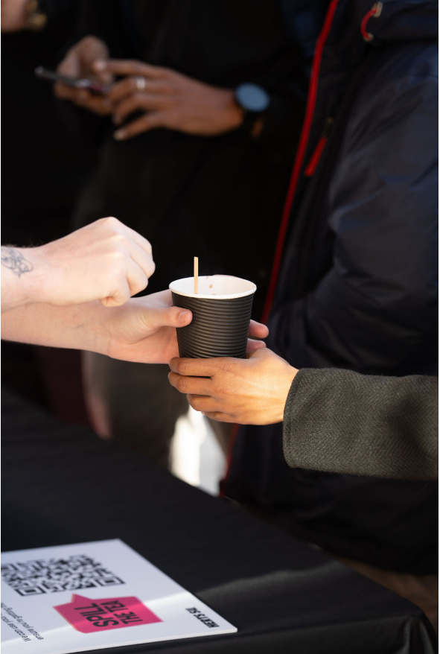
QUESTIONS?
Happy to talk about any of it — including the parts that went wrong.
Muhammad Sakib
Insights Team | Hertfordshire Students' Union
m.sakib@herts.ac.uk
16

