Slide 1


How useful are Management Accounts
To our various stakeholders

Slide 2

Hello!
My name is Julie
I have worked at BSU for 18 months
This is my first role working for a charity – BSU
Previously I have worked for various organisations – Banking, Estate Agencies (mortgages)
Manufacturing, Medical Communication
Recruitment, IT Product & Software

Slide 3


What are Management accounts?
Financial reports - usually prepared monthly
Income & Expenditure - Actuals vs Budget
What has happened?
What happens next.

Slide 4
Stakeholders (in our organisation)
Lay Trustees
Elected Trustees
Student Trustees
Vice Chancellor - BNU
CEO – BSU
Head of People & Development - BSU

Slide 5
Why are they useful?
Better control – on overspend/variances
Enable better/quicker decision making – potential new projects, recruitment, student demand
Highlight issues early

Slide 6
The Student Union challenge
SU’s mix charity work & businesses
Grants
Commercial areas
Student clubs & societies

Slide 7


Management Accounts
S – Specific
M – Measurable
A – Accurate
R – Relevant
T - Timely

Slide 8


Specific
For Non Finance personnel
Use accessible language/colour code
Don’t assume – explain variances
Graphs/different layouts
By department of cost centre

Slide 9


How to share information
Area | Budget | Actual | Variance | Status
Commercial | £420k | £438k | +£18k | 🟢
Advice Service | £145k | £152k | -£7k | 🟠
Student Activities | £210k | £198k | +£12k | 🟢
Events | £95k | £118k | -£23k | 🔴
Overall Surplus | £40k | £12k | -£28k | 🔴

Slide 10
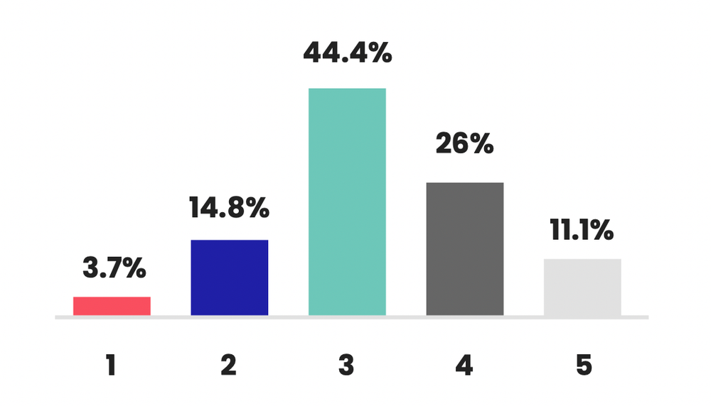
How to share information

Slide 11
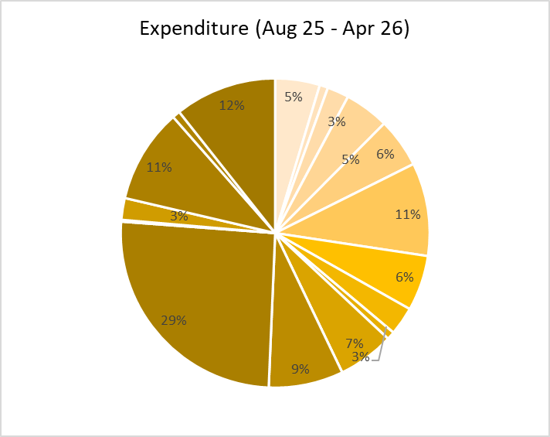
How to share information

Slide 12
Measurable
Actual vs Budget/Prior Year
Variances - £ and %
Net Surplus/Deficit
KPI’s

Slide 13
Achievable (Accurate)
Income & expenditure
Activity by dept. (correctly coded)
Trading/Commercial figures
Balance Sheet

Slide 14
Relevant
Grant income & expenditure
Trading/Commercial activities
Student Activities & Rep spending
Operational costs
Net Surplus/Deficit
Balance sheet

Slide 15
Timely
Date of Finance Meetings
Review previous months accounts –
including accruals/prepayments
Discuss current months activities
Share forecasts

Slide 16
How do you present yours?
What is included? What do you share?
How many days after month end?
What questions are you asked?
How have your management accounts changed?
Do you have a separate narrative to Excels?
Had any feedback? What is most useful?

