Slide 1

Supporting Neurodivergent Students: Building Neuro-Inclusive Students' Unions
Charlotte Stewart: Head of Disability & Inclusion at Bucks New University

Slide 2
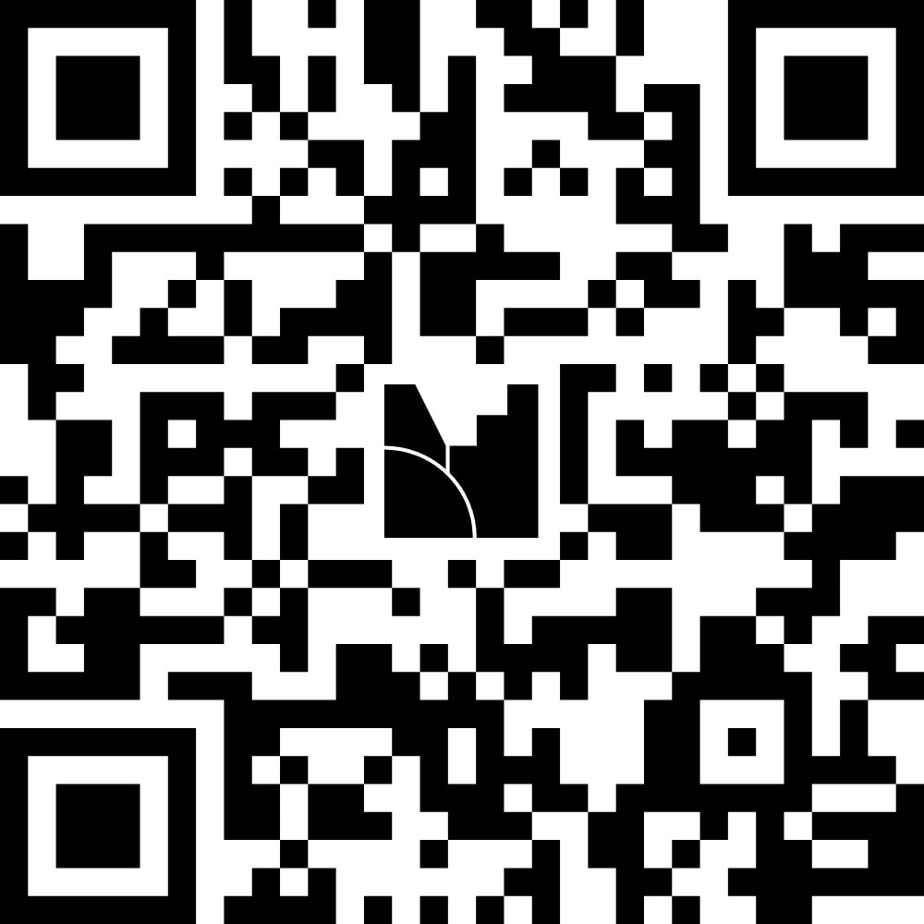
How confident do you feel that your Students' Union is neuro-inclusive?
Very confident
Fairly confident
Not sure
We have work to do
Scan the QR code or go to menti.com and type in this code: 2688 8589
Notes:
"By the end of today, I don't want you to feel guilty.""I want you to leave with some practical ideas and a plan."

Slide 3
What We Will Explore Today
Why neurodiversity matters to Student Unions
Barriers across the student journey
Freshers, activities, democracy and services
What neuro-inclusive practice looks like
Practical actions you can take immediately
Notes:
This is not a clinical session.
You don't need to become an expert in ADHD or autism.
Instead, we're going to explore where Student Unions unintentionally create barriers and what practical changes can make the biggest difference.

Slide 4
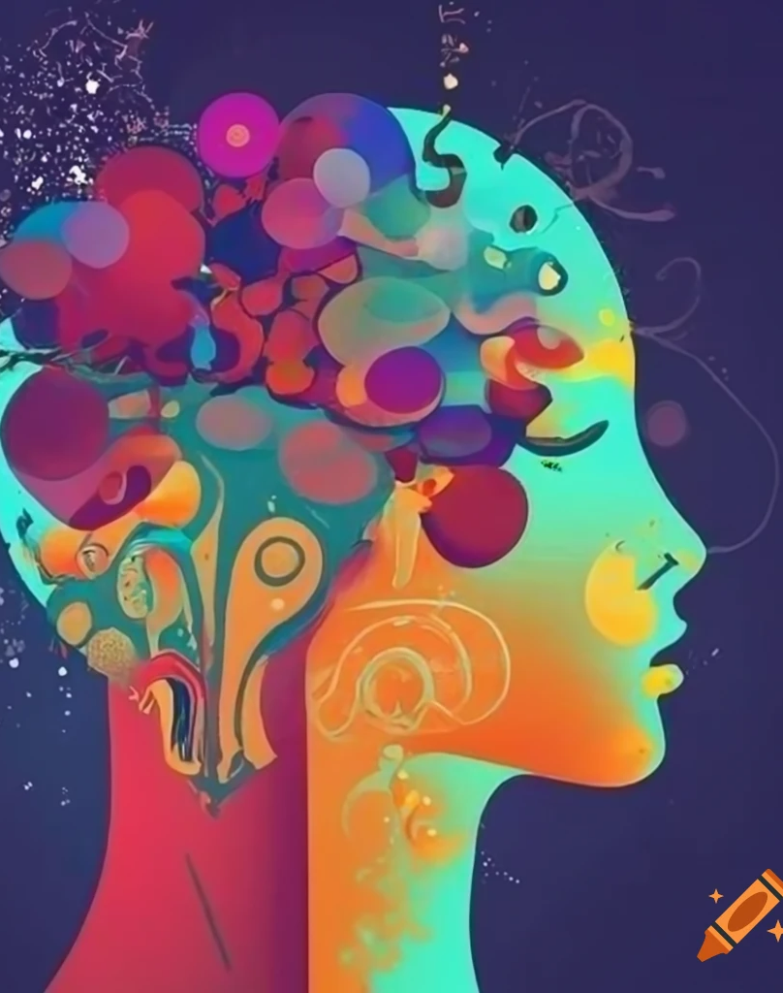
My Perspective
Head of Disability & Inclusion
Student ADHD lived experience
Years supporting disabled students
One neurodivergent person does not represent all neurodivergent people.
Notes:
Everything I'm about to discuss is informed by both professional practice and lived experience.
But one of the most important lessons I've learned is this: If you've met one person with ADHD...You've met one person with ADHD.
The same applies to autism, dyslexia and many other neurodivergent conditions.

Slide 5
What is Neurodiversity?
Neurodiversity recognises neurological differences as natural human variation.
Examples include:
  ADHD
  Autism
  Dyslexia
  Dyspraxia
  Dyscalculia
  Tourette Syndrome
  Developmental Language Disorder
Many students experience multiple conditions.
Notes:
The important point is that neurological differences are a normal aspect of human diversity, not something rare or unusual.

Slide 6
Three Ways of Thinking About Disability
Medical Model
Social Model
Affirmation Model
“What strengths and value does difference bring?"
"What is wrong with the student?“
"What barriers have we created?“
Notes:
This may be the most important slide of today's session.
Everything we do as leaders is shaped by which model we operate from.
Most Student Unions would say they support the social model.
But do our systems reflect that?
Or do they still rely on students proving they deserve support?

Slide 7
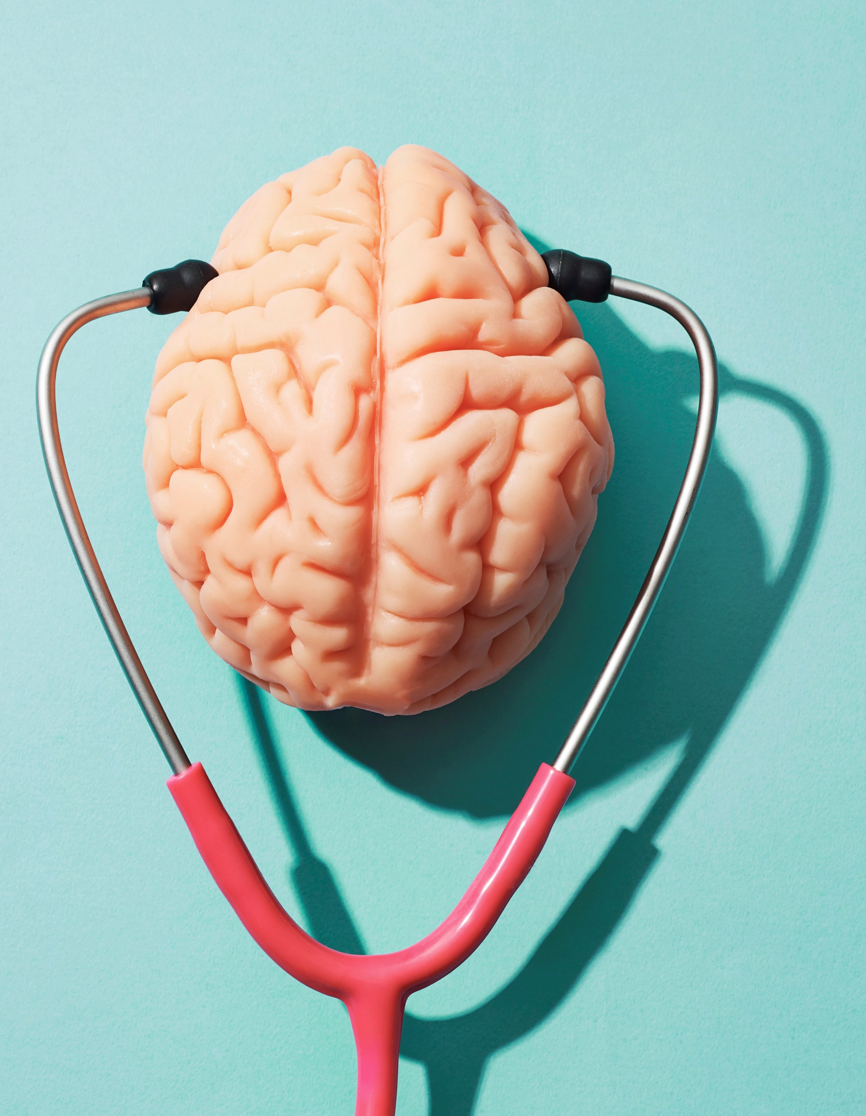
Are Student Unions Designed For Neurotypical Students?
Think about:
  Venues
  Events
  Elections
  Advice services
  Communications
  Participation
Notes:
This is the central question.
Not: "How do we support neurodivergent people?“
Instead: "Who did we have in mind when we designed our services?"

Slide 8

The Student Journey
Freshers' Fair
Joining a club or society
Seeking advice and support
Participating in democracy
Running for office
Becoming a student leader
Where do barriers appear?
Notes:
"Which of these stages do you think contains the biggest barriers?“

Slide 9
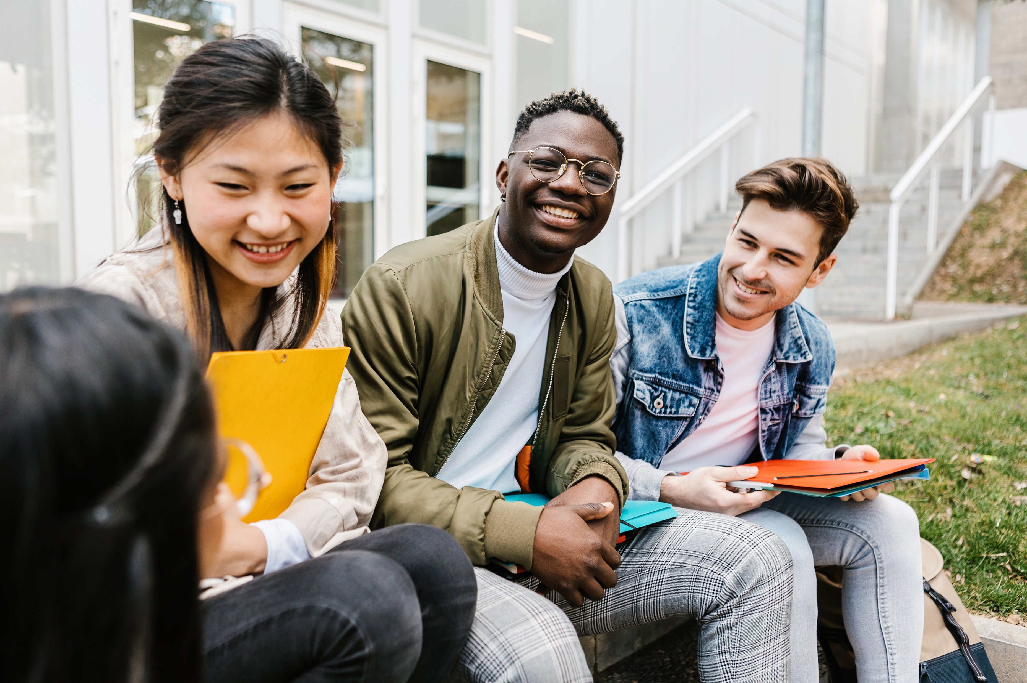
Freshers Fair
For some students:
  Crowds
  Noise
  Bright lighting
  Information overload
  Social pressure
  Sensory overwhelm
Activity: If you redesigned Freshers' Fair tomorrow, what would you change?
Notes:
When we think Freshers' Fair we think:
Exciting. Welcoming. Energetic.
Some students experience:
Exhausting. Overwhelming. Terrifying.
For some neurodivergent students Freshers' Fair isn't a gateway to belonging.
It's a reason to go home.
Likely answers:
Quiet sessions
Reduced noise
Low-sensory hours
Better maps
Smaller welcome events

Slide 10
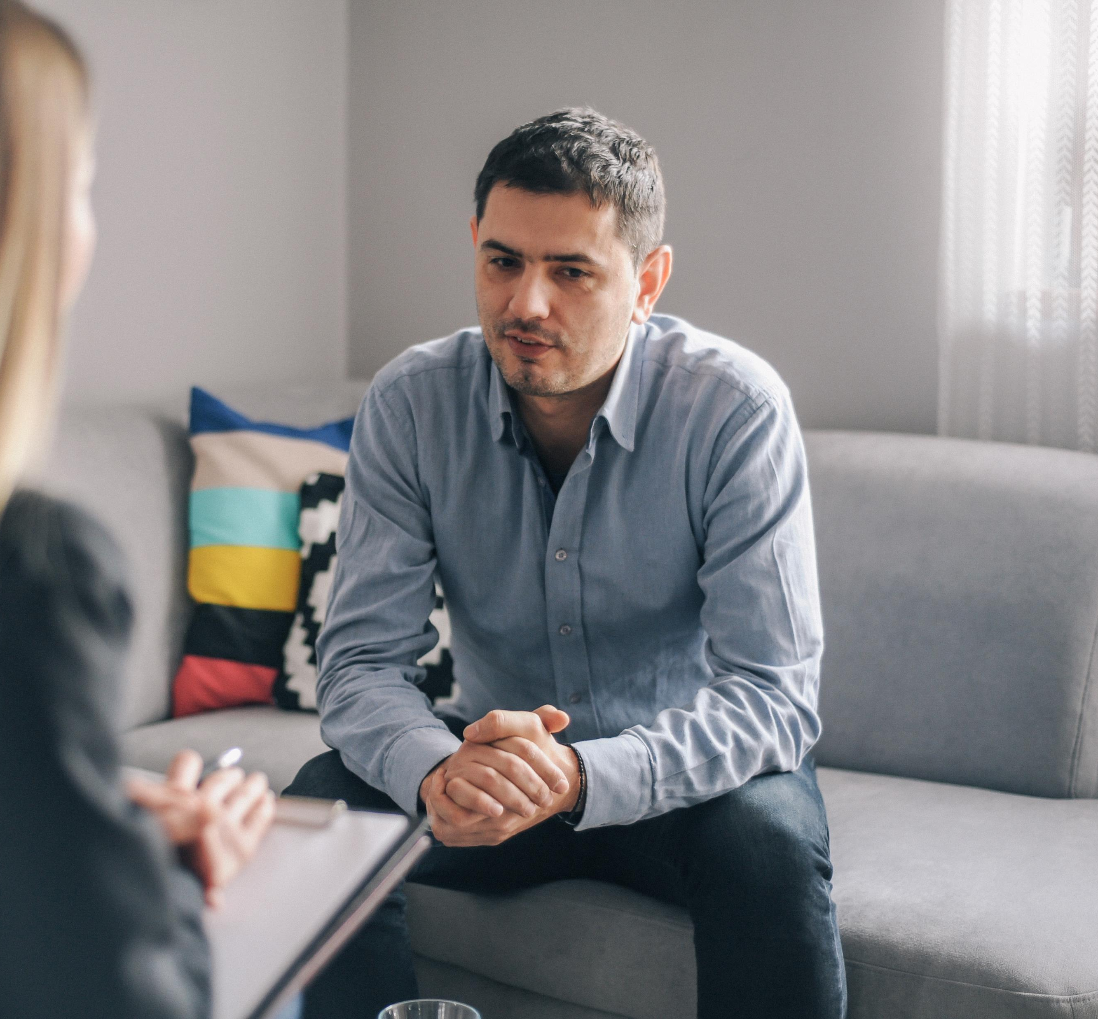
Activity: Spot The Barriers
Advice services sign up:
"Please complete the referral form and upload supporting evidence. You will then be contacted regarding an appointment.“
How many barriers can you spot?
Notes:
Potential barriers include:
Executive functioning
Ambiguous instructions
Unclear timelines
Anxiety
Information overload
Unclear next steps
Many students never access support.
Not because they don't need support.
Because accessing support itself becomes a barrier.

Slide 11
Democracy & Representation
Potential barriers:
  Public speaking
  Debates
  Large meetings
  Campaigning expectations
  Last-minute information
Are we selecting the best leaders? Or are we selecting the people most comfortable speaking in front of 200 people? Those are not always the same thing.
Democracy should not only work for confident public speakers.
Neuro-Inclusive Democracy
Hybrid engagement
Written questions
Pre-recorded speeches
Accessible manifestos
Alternative participation routes

Slide 12
Hidden Exclusion
Students may be perceived as…
Disengaged
When they may be…
Overwhelmed
Lazy
Difficult
Disorganised
Uncommitted
Masking
Exhausted
Struggling with executive functioning
Notes:
This is where stigma appears.
Behaviour is often interpreted before it is understood.
Many neurodivergent students spend enormous energy simply coping.

Slide 13

What Good Looks Like
Neuro-Inclusive Design Principles
  Design inclusively
  Reduce sensory burden
  Make information explicit
  Build flexibility
  Co-design with students
Notes:
These principles apply to almost every service your SU delivers.

Slide 14
Practical Examples
Neuro-Inclusive Venues
  Quiet sessions
  Sensory-friendly spaces
  Better signage
  Improved acoustics
  Flexible seating
  Predictable lighting
What would your busiest venue feel like for an autistic student at peak time?
Neuro-Inclusive Activities
  Written agendas
  Structured first meetings
  Flexible participation
  Alternatives to ice-breakers
  Smaller group opportunities
People often assume inclusion requires expensive solutions – usually it requires better planning.

Slide 15

Beyond Removing Barriers
Neurodivergent students often bring:
  Creativity
  Innovation
  Hyperfocus
  Pattern recognition
  Different perspectives
  Challenge to groupthink
Building Neurodiversity Confidence
  Staff training
  Officer development
  Neurodiversity champions
  Co-production
  Continuous learning
Notes:
This is where many inclusion conversations stop.
At support.
But inclusion is also about recognising talent.
The goal is not simply access.
It is participation, leadership and success.
Awareness is not enough.
We need confidence.
We need practical competence.
And we need accountability.

Slide 16
Action Planning
One thing you can do tomorrow
One thing you can do before Freshers
One thing you can do this academic year
Notes:
Give delegates 3-4 minutes.
Ask them to write actual commitments.
Encourage discussion at tables.

Slide 17
The question is not: "How do we support neurodivergent students?”
The question is: "How do we create Students' Unions where neurodivergent students can belong, participate and lead?"
Notes:
"If you only remember one thing from today, remember this:
When neurodivergent students struggle, our first question should not be 'What's wrong with the student?'
It should be 'What might be wrong with the experience we've designed?'"

Slide 18

Questions & Discussion

