Slide 1


Supporting Student Mental Health and Building Resilience
Bill Sheate bill@imaginationtherapy.co.uk www.imaginationtherapy.co.uk

Slide 2
Summary
Summary
Understanding the relationship between thoughts, feelings, and behaviour
Understanding stress, worry and anxiety (students, and your own)
  ‘Mindful learning’ (and work)
  Unhelpful coping strategies – worry, perfectionism, and procrastination – what are they, and how do individuals respond to stressors?
Practical skills for building resilience and self-efficacy and changing our response to stress:
  Simple mindfulness techniques
  Practical problem-solving
  The ‘Relaxation Response’ - you can’t be anxious and relaxed at the same time!
Q&A

Slide 3
Examples of common student mental health issues
Student anxiety, stress, and worry about:
  Exams, assignments, group work, friendships/relationships, finance, family, social media, technology/smart phones, climate crisis
Evidence of decreased resilience among young people
  Doubling of people in the UK with poor mental health since 2010 (Vriend et al, 2023; Pierce et al 2025)
Unhelpful coping strategies:
  Often developed through school pressures/performance
  avoidance, worry, perfectionism, and procrastination – what are they, and how do individuals respond to stressors?
  self-isolation (post-Covid), low tolerance of low-level stress, e.g. avoidance via headphone use (Liu et al, 2025)
Symptoms v labels – anxiety is a normal human emotion (and not a disability for most people)
  ‘desire for diagnosis’ and self-diagnosis; ‘comparisonitis’

Slide 4
The ABCs
Activating event
Beliefs
Consequences
The way we respond to events/situations is not due to the event itself but our
interpretation of it, i.e. it is mediated by our core beliefs/assumptions (Ellis, 1962)
Affect (feelings)
Cognition (thoughts)
Behaviour (actions)

Slide 5
Mindfulness and pop-up thoughts
Involuntary
Voluntary
Pop-up thought
Focusing on a task in hand
Worry – future focused (What if?)
Rumination – past focused (Why?)

Slide 6
Mindful learning (or work)
What do we mean by mindful learning?
  Engaging in learning – and the process of learning - in the present moment
  Not solely focused on outcomes (future focus) - results
    Engage (and act) fully with complete awareness of the present moment
  Focused (when necessary), not distracted
  Non-judgemental – group work, assignments, assessments, exams – they are present moment experiences that, if framed as consolidating learning, become less stressful
  A course offers the opportunity to learn
    Fees are for the learning environment; to be taught by experts in the field.

Slide 7

TRIGGER/STRESSOR
e.g. exams/work deadline/boss
Lazarus’s transactional model of stress
(1966, 1984)
More info, see blog at
https://www.imaginationtherapy.co.uk/
1º Appraisal
+ ve, - ve or challenge
2º Appraisal
(in)ability to cope (resources/capacity)
CORE BELIEF
I can’t cope; I hate exams/work
Problem-based response
e.g. work harder/later (cramming); procrastination; worry
Emotion-based response
e.g. Anxiety
Consequences: e.g.
poor sleep, low mood, tiredness
ALTERNATIVE
E.G. Ask for help; refuse unrealistic demands
Exams - active revision (problem solving/practice planning answers
ALTERNATIVE
E.G.
RELAXATION
MINDFULNESS
A vicious cycle can be established. But can change primary or secondary appraisals and/or responses. In some cases may need to remove stressor, e.g. change jobs.
Note: Stress = process; Anxiety = emotional response

Slide 8
Threat
Severity
Likelihood
Vulnerability
Ability to cope
Anxiety model
(based on Clark and Beck, 2010)
‘Something bad is going to happen and I won’t be able to cope’
Under-estimating
And ignore safety signals
Over-estimating

Slide 9
Anxiety ‘hump’
Anxiety
Avoidance here
Time (proximity to event)

Slide 10

Mindfulness
“Paying attention in a particular way: on purpose, in the present moment, and non-judgementally.” (Kabat-Zin, 1979)
Example simple mindfulness techniques, exercises:
Present moment:
  5 things – see, hear, sensation against the surface of the skin
    Remove headphones and connect – deliberate action
Acceptance (of emotions):
  Not struggling (e.g. finger trap metaphor; ball in pool)
  ‘OK I’m feeling anxious – it’s OK it will pass’
Defusion distancing (of thoughts):
  hands as thoughts;
    e.g. ‘I’m not good enough’; I’m having the thought…..; I’m aware I’m having the thought……
Observer of self:
  Sky and weather metaphor

Slide 11
Worry….
‘Problem situation’
  Any current or anticipated life situation which requires some response, but to which no effective or adaptive response is immediately obvious
‘Worry’
  Prolonged and fruitless search for a solution that will provide safety from the perceived threat of harm (Clark and Beck, 2010)
  The brain’s random attempt at problem solving, to little effect

Slide 12
(Unproductive) Worry
– an unhelpful coping strategy for anxiety
Dwells on unanswerable questions (or unsolvable problems)
Involves long chains of events leading to distant catastrophes
Rejects potential solutions because they are not ‘perfect’, i.e intolerant of uncertainty
Prolongs thinking in an attempt to reduce anxiety, i.e. an endless search for safety
Fails to distinguish between what can be controlled and what cannot.
See blog post on Worry

Slide 13
Unhelpful coping strategies (1)
Perfectionism
  A cognitive distortion and an unhelpful coping strategy
  No such thing as ‘perfect’
  Sets an unachievable goal; never satisfied
  Often goes with ‘comparisonitis’ – comparing yourself to others
  At root is a belief that you ‘should’ be perfect – ‘if I strive to be perfect I won’t ‘feel’ I’m not good enough’ – creates a vicious cycle
    'But if I do all in my power to be perfect then I'll prove to others (and myself) I'm not as useless as I think I am.'
  Results in low self worth, constantly seeking external validation, not trusting self.
  See Perfectionism blog https://www.imaginationtherapy.co.uk/blog/2018/12/11/perfectionism-the-modern-scourge
  Unwritten rules blog – I should, I must, I need https://www.imaginationtherapy.co.uk/blog/2019/1/24/unwritten-rules-i-should-i-must-i-need

Slide 14
More helpful strategies
Rather than ‘perfect’, which is unachievable, how about being ‘competent’?
  Can be competent at lots of things
  Rather than ‘I must do well’, ‘It would be nice to do well, but it isn’t essential’
Perfectionism is future – outcome – focused; instead focus on the process of learning, on the task in hand
  Mindful learning
But what will others think of me?
  Expectations of others are their concern, unless you adopt those expectations as you own
  Trust yourself, your own judgements
  Acceptance – that part of being human is to be average, below average and above average for different things:
    You can be good at some subjects, but very unlikely to be equally good at all – why should you be?
    Can you accept that fact?

Slide 15
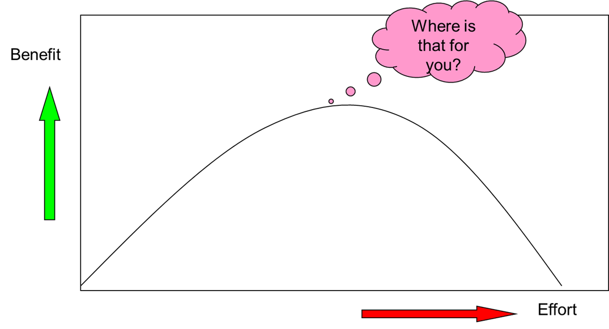
Benefit v effort

Slide 16
Unhelpful coping strategies (2)
Procrastination
  Doing something other than the thing that is important, for immediate gratification (behavioural response)
    E.g. scrolling through phone, social media, YouTube videos, cleaning your room/flat etc
  Lowers immediate anxiety temporarily about the thing causing anxiety, BUT
  Is essentially avoidance – safety seeking when ‘overwhelmed’, and so makes things worse (vicious cycle)
    E.g. Not starting something you can’t be perfect at; or stressful > rather not submit at all than submit something less than perfect > debilitating
  Or, may be used to create anxiety to provide the impetus to do the work (e.g. deadlines)
  See Procrastination blog https://www.imaginationtherapy.co.uk/blog/2019/2/28/procrastination-a-waste-of-time
  More helpful strategy – problem solving (below)

Slide 17
Problem solving theory
Worry decision tree
What are you worrying about? [problem definition]
    e.g. ‘I can’t cope with the workload’ (overwhelmed)
Can you actually do anything about it?
  No. Stop worrying and shift your attention to something else (or mindfulness – let it go) [End]
  Yes. Work out what you could realistically do and make an action plan [problem solving]
    Can you do anything practical right now? [solution implementation]
      No. Plan when you are going to do it. Now stop worrying and shift your attention to something else (or mindfulness – let it go) [End]
      Yes. Do it now. Now stop worrying and shift your attention to something else (or mindfulness – let it go) [End]

Slide 18
Problem solving theory
The process
Define the problem
What is your goal?
What are the options/solutions? [Brainstorming]
Weigh up the options (pros & cons)
Choose a solution
Make a plan of action [Action]
Problem
Decision

Slide 19

Defining the problem – ‘W’ questions
Problem definition:
Who is present/affected when the problem occurs?
What does or doesn't happen that's particularly troubling you?
Where does the problem happen? Where are you when it happens?
When does the problem happen? When does it need to be resolved by?
Why does the problem happen? Why is it a problem? Why do you respond the way you do?
How did you respond to the problem? What were your thoughts, actions, and feelings?
[note these are generic for all sorts of personal or other problems]

Slide 20
Brainstorming options and deciding on solutions
What is the problem? E.g. I can’t cope with the workload
  Define the problem accurately (‘W’ questions).
What is your main (SMART) goal?
  (‘perfect’ is not SMART)
Brainstorm as many alternative solutions as possible
  Keep brainstorming; don’t get distracted by evaluating too soon
Choose the best proposed solution(s) or merge ideas and summarise your decision.
  Some will drop out easily
Weigh up the pros and cons of the best proposed solution(s)
  Use two columns
How can you maximise the pros and minimise or prevent the cons?
Plan and schedule the individual steps required to put the best solution into action.

Slide 21
Conclusions – applying it in practice
ADAPT
Attitude
  Adopt a positive and optimistic problem-solving attitude (orientation) from the out-set and throughout all the steps
Define
  Develop a clear, objective and accurate definition of your problem, goals and any obstacles
Alternatives
  Brainstorm a variety of alternative solutions for overcoming your problem and achieving your goal
Predict
  Weigh up the pros and cons (consequences) of your options and choose the best solution
Try it out
  Put your best solution into practice, evaluate the outcome, praise or reward your efforts, and try again until the problem is solved.

Slide 22
And finally… the ‘Relaxation Response’
Opposite of the ‘Fight or Flight’ Response (fear/anger/anxiety)
Parasympathetic nervous system calming the body (and mind)
Brought about by breathing:
  Deep (belly/diaphragmatic) breathing
  Long slow soft exhalations
Hand on belly as if inflating a balloon as inhale through the nose
Hold the breath
Long soft exhalation through the mouth

Slide 23


Any questions?
Thank you!
bill@imaginationtherapy.co.uk
https://www.imaginationtherapy.co.uk/

Slide 24
Further resources
Imaginationtherapy.co.uk various information and blog posts on mindfulness, stress and anxiety – see https://www.imaginationtherapy.co.uk/blog;
  E.g. Worry - what is it and how to deal with it?
  also on eco-anxiety https://www.imaginationtherapy.co.uk/issues#ecoanxiety
Russ Harris (2008) The Happiness Trap, London: Constable Robinson
Jon Kabat-Zin (2012) Mindfulness for Beginnners, Boulder, Colarado: Sounds True (and an aray of other books, CDs etc).
Donald Robertson (2012) Build Your Resilience, London: Hodder Education.
  mindfulness, acceptance, relaxation - a whole programme to develop resilience to stress and anxiety
GreaterGood Magazine https://greatergood.berkeley.edu/
Headspace app - at https://www.headspace.com/
Buddhify app - at https://buddhify.com/
Calm app (sleep, meditation) – at https://www.calm.com/

